Slide 1
Group 9 Tableau Project
File created on: 12/16/25 9:51:24 AM EDT

Slide 2


Slide 3
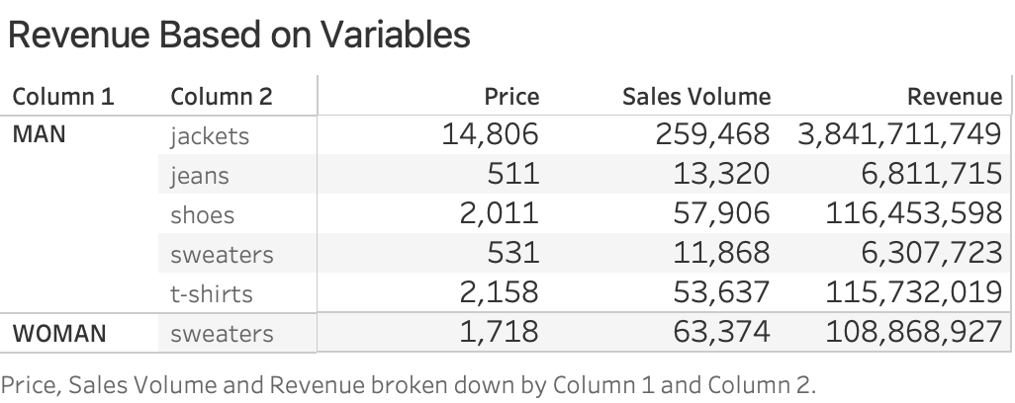

Slide 4
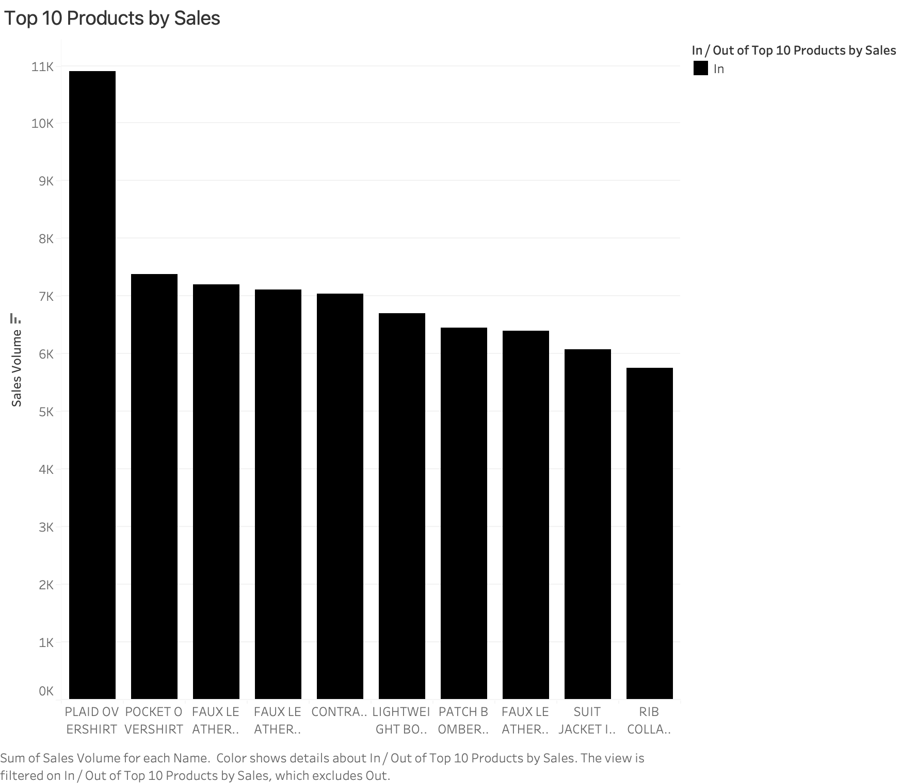

Slide 5
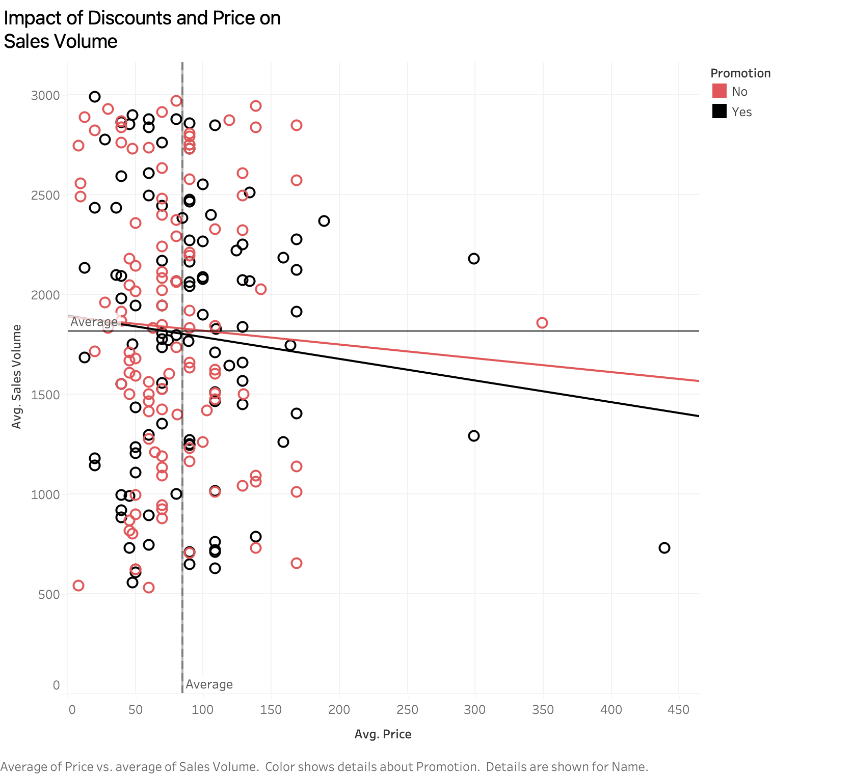

Slide 6
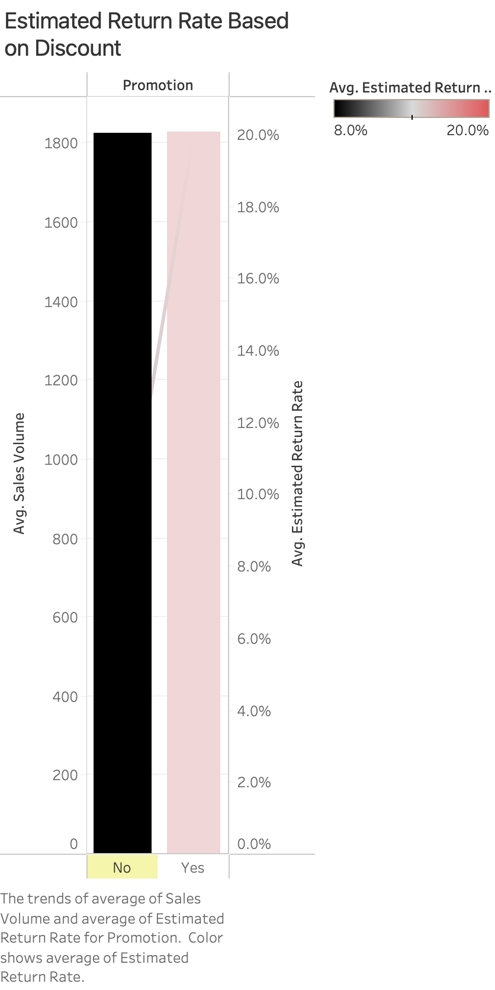

Slide 7
